Slide 1
Linear Models
13th Sep 2019

Slide 2
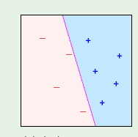
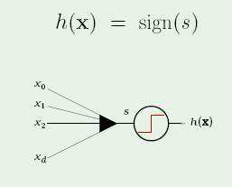
Perceptron
Works if Data is linearly Separable
s = ???
Realisation

Slide 3
Perceptron -Trivia
Invented in 1957 by Frank Rosenblatt
"the embryo of an electronic computer that [the Navy] expects will be able to walk, talk, see, write, reproduce itself and be conscious of its existence."
In 1969 a famous book entitled “Perceptions” by Minsky & Papert , they showed that it was impossible for Perceptron to learn an XOR function.

Slide 4
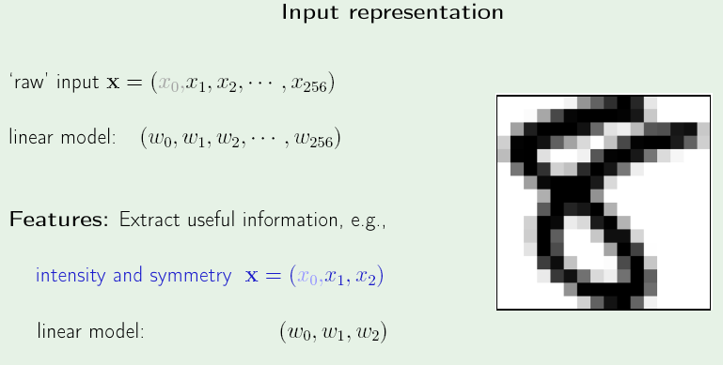
Perceptron - MNIST

Slide 5
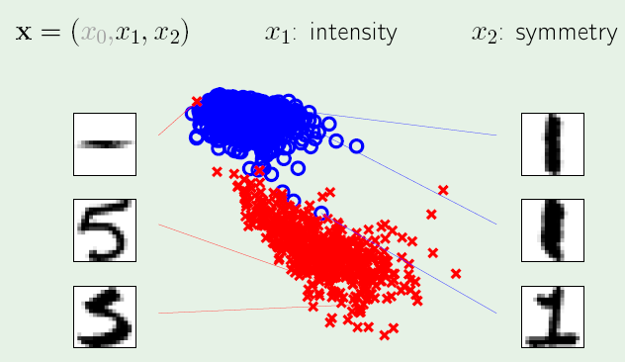
Feature Space

Slide 6
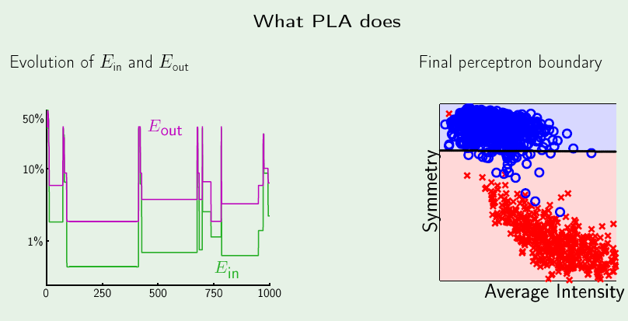
PLA - Iterations

Slide 7
Pocket - Version

Slide 8
PLA Vs Pocket

Slide 9
To Do
Perceptron on MNIST Data
Take 2 classes at a time and check if 2 confusing classes such as “1” and “7” can be classified using Perceptron
What is the cost function we are minimizing in Perceptron ?
Apply Gradient Descent to this cost function
Prove : Convergence of Perceptron

Slide 10
Perceptron - Drawbacks
It may take too many iterations
Works only if data is linearly separable
………………

Slide 12
More Linear Models….

Slide 13
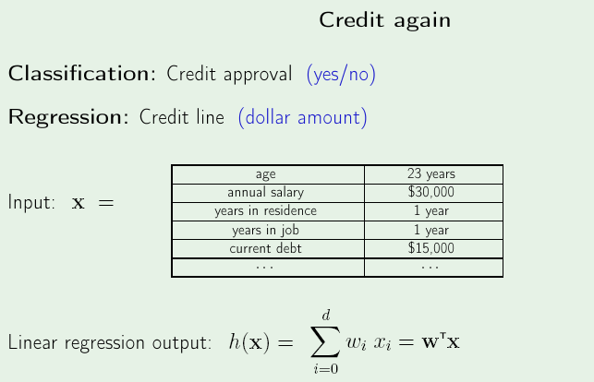
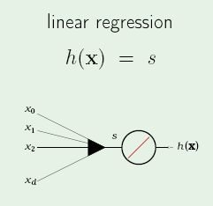
Linear Regression (Real-valued output)

Slide 14
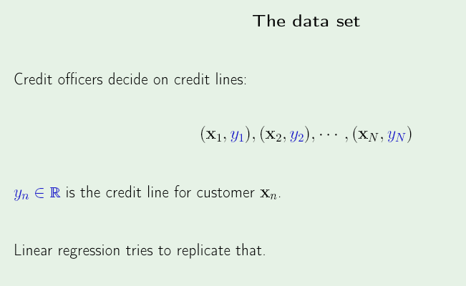
Linear Regression - Objective

Slide 15
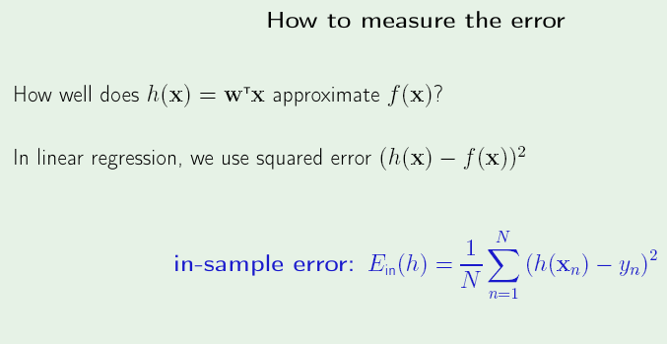
Cost function
Please Remember :
Training Error = In-sample error
Testing Error = Out-of-sample error

Slide 16
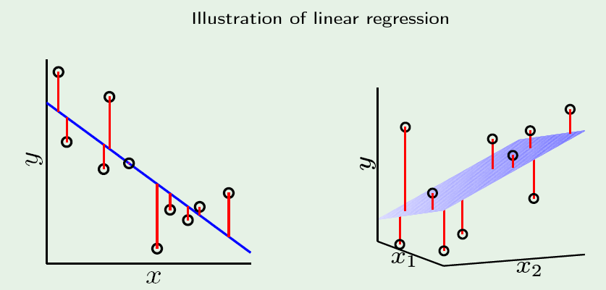
Cost function contribution
Notice : All data points that are not on the line contribute to the cost function

Slide 17
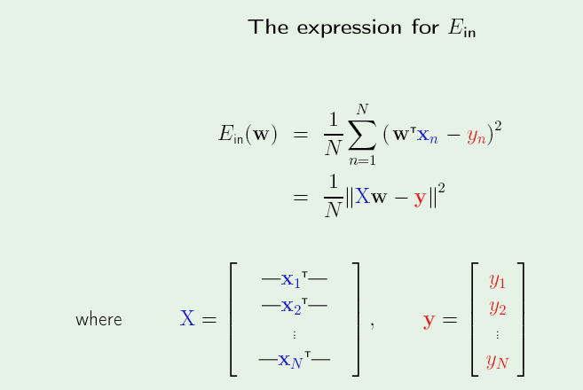
Cost function - Rewriting
Notice : All data points x₁, x₂…..x_{N} contribute to the cost function

Slide 18
Vector calculus - Hints
Given that w is a vector and U is a matrix/vector
(1) d/dw (U^{T}w) = U
(2) d/dw (w^{T}Uw) = 2Uw

Slide 19
Error measure, J = ||y-Xw||²
J = (y – Xw)^{T}(y-Xw), Expanding Norm ||y-Xw||²
^{Expand the brackets :}
J = [y^{T} – (Xw) ^{T}][y – Xw]
= yTy- (Xw)Ty- yTXw + (Xw)T (Xw)
^{= yTy - 2 yTXw + wTXTXw}
dJ/dw = 0 – d/dw(2 yTXw ) + d/dw(wTXTXw)
^{= -2 (yTX) T + 2 XTXw}

Slide 20
Setting dJ/dw = 0
^{-2 (yTX) T + 2 XTXw = 0}
^{(yTX) T =} ^{XTXw}
^{XTXw = (yTX) T = XTy}
^{w} ^{= (XTX) -1 XT}
Hence w is the Pseudo Inverse of X

Slide 21
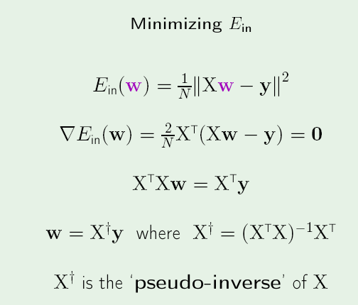

Slide 22
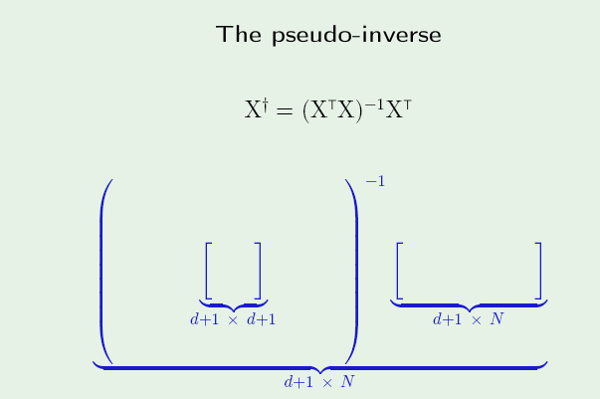
Pseudo-inverse Dimensions
Think : What if “d” was a large number ?!?

Slide 23
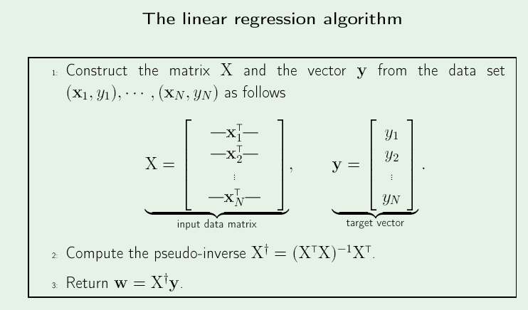
Notice : All Data points are dealt with, in one shot !! (Unlike Perceptron)

Slide 24
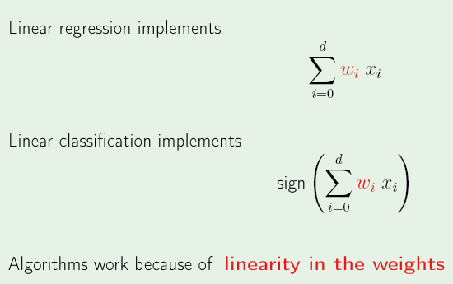
Linear Models - Summary
Remember : The “x” values are frozen; The unknowns are “w”

Slide 25
Probabilistic Interpretation
The Mean value of “y” given “x” ie. E[y|x] will lie on the straight line
Minimizing the squared error = Maximizing the Likelihood (Assuming Gaussian)

Slide 26
Cost function
Can we think of any other way of quantifying error ?
How about 1-norm of the Deviation ?
How will we know when to choose 1-norm, when to choose 2-norm ?

Slide 27
Regularized Solutions
Modified Cost function = E(w) + λR(w),
Here, λ = Regularization parameter
R(w) = Captures Model Complexity ( Norm (w))
E(w) = Error Term (Eg. Squared sum of Residuals)
This kind of Optimization is called : Constrained Optimization
Tradeoffs : λ Large => We want a simple model, Large Error is Tolerable
λ Small => We want Lower Error, Even if Model is complex

Slide 28
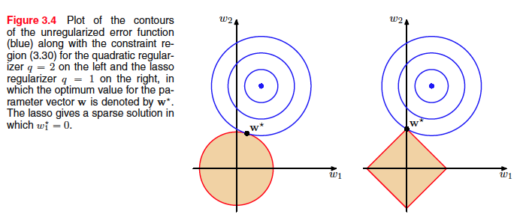
Visualizing constraints
l2 Regularization (|w|²)
Ridge Regularization
l1 Regularization (|w|)
Lasso Regularization

Slide 29
Variants in Regularizations
Elastic Regularization
Linear Combination of l1 and l2 Norms

Slide 30
Can Linear Regression be adapted to be used as a classifier ?

Slide 31
Logistic Regression

Slide 32

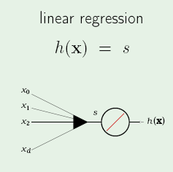
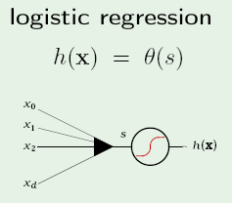
Linear Models – Contd…
Note : The logistic function behaves “linearly” in a certain interval ; It behaves like the Signum function at the tails

Slide 33
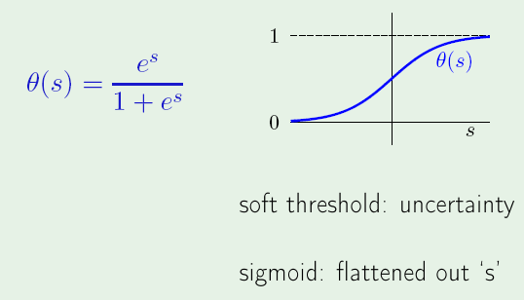
Logistic (Sigmoid) function
Where,

Slide 34
Logistic – Salient features
How steep is the slope ?
Where does it reach at s = 0 ?

Slide 35
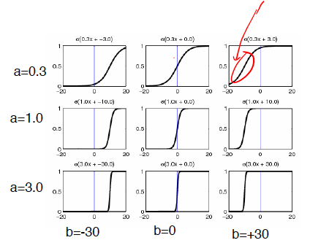
Family of Logistic curves

Slide 36
Logistic (Sigmoid) function
Maps real line to [0,1]
Can be used to model posterior probability i.e P(C | x)
Final goal: Feature as input and output as posterior probability,
using the sigmoid model
Step 1: Take linear combination of features (similar to Linear Regression)
Step 2: Apply sigmoid function

Slide 37
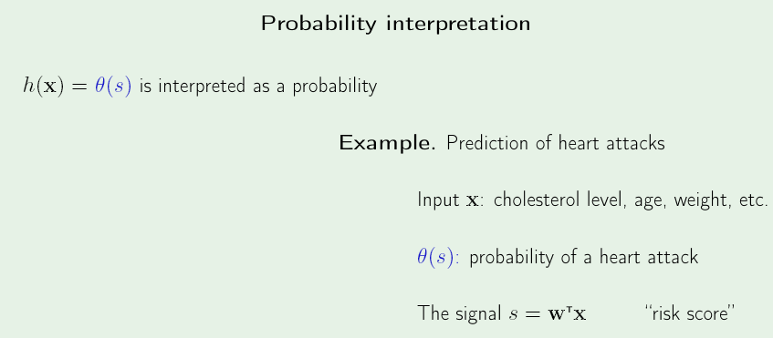
Logistic Regression
Where,
What happens when -----
Risk score is high ?? s is large; Ɵ(s) -> 1
Risk score is low ?? s is small; Ɵ(s) -> 0

Slide 38
To do
Prove :
1) Θ(-s) = 1 - Θ(s)
2) Θ’(s) = Θ(s) Θ(-s)

Slide 39
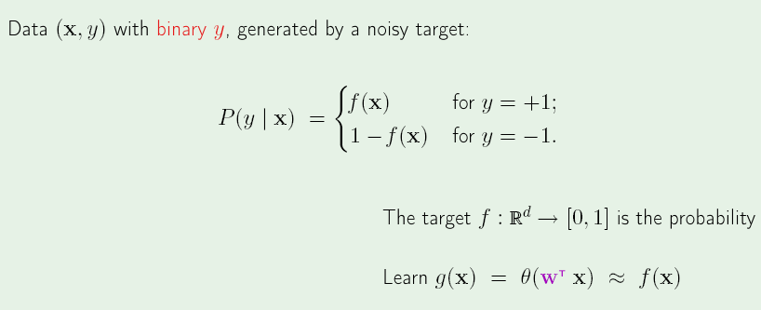
From Discrete to Real-valued
Data tuples given (x,y) represent :
x = [Age, cholesterol level, weight]
y = +1 (Had a heart attack) or -1 (Didn’t have a heart attack)
But we would have wanted the “Probability of Heart Attack” given the Pattern x
If “f” is the IDEAL function that takes in input Pattern “x” and outputs the probability that the pattern “x” will lead to a Heart Attack

Slide 40
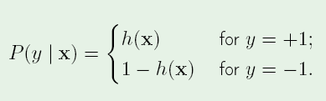
How to quantify the error ?
For each (x,y), y is generated by probability f(x)
We are trying to learn “f”
If we use “h” as approximation to “f”, it means
If h = f, how likely are we to get y from x

Slide 41

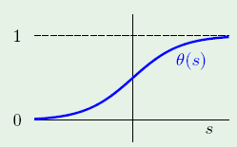





MLE - Estimation
Given pattern “x”, what is the likelihood that “y” is generated by “h” :
Re-writing P(y|x), using odd symmetry about 0.5

Slide 42


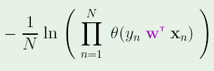

Maximizing the Likelihood
Maximize
Maximize the log
Maximize scaled version
Minimize
Same as minimizing

Slide 43


MLE
Error Measure =
Re-write the Error Measure, expanding Ɵ
If (y_{n}) and (w^{T}x_{n}) have same sign, then it contributes e^{-ve} number ;
Hence contribution is small (i.e Hypothesis is correct for that point)
If (y_{n}) and (w^{T}x_{n}) have opposite signs, then it contributes e^{+ve} number ;
Hence contribution is large (i.e Hypothesis is wrong for that point)
Hence we need to minimize the Error Measure
Objective : Find that parameter “w” that minimizes the Error measure

Slide 44
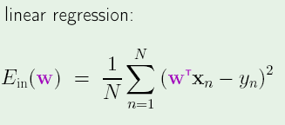
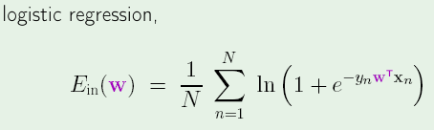
MLE
We got a closed form solution !!
Closed form solution not possible ☹
Way ahead : Iterative solution

Slide 45
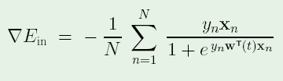

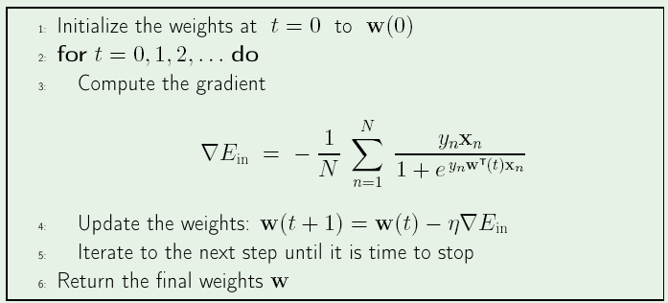
Gradient Descent
Initialize w as w(t)
Differentiate Error wrt w :

Slide 46
Conclusion
Logistic Regression
Classifier: Logistic idea + Linear Regression
Discriminative model (vs Generative model)
Parameters – feature weights
Estimation – ML estimation
Gradient Descent (Iterative Method)
Summary : Maximum likelihood estimation of ”w” assuming that the observed training set was generated by a binomial model

Slide 47
Other Linear Models..

